Slide 1

IBM Project Presentation on Real-Time Monitoring and Evaluation System for Fire
Department Applications
By Group ID: G18
MUNISH PATWA [21162121017]
ASTIK SAXENA [21162171002]
PANJWANI ANIKET [22162102002]
Institute of Computer Technology, Ganpat University
Date: 22 February 2025

Slide 2
Table of Contents
Introduction
Objectives
Related Background
Expected Outcome
Tools & Technology
Methodology (Modules)
Workflow Diagram
Project Timeline
Implementation Details
Conclusion
References

Slide 3
Introduction
Project Scope:
This project aims to develop a fully functional fire detection system that can detect fire in real time and send immediate notifications to the concerned authorities or individuals.The system will use advanced machine learning algorithms for fire detection and integrate various technologies for alerting, monitoring, and logging events.
Importance:
Fire safety is a critical concern in both residential and commercial spaces. Early detection of fire can prevent significant damage to life and property.
Our system leverages real-time data processing to provide an automated response in case of fire hazards, ensuring quicker intervention and increased safety.

Slide 4
Objectives
Fire & Smoke Detection:
Implement a system capable of detecting fire/smoke using computer vision techniques (OpenCV) and YOLOv8, ensuring high accuracy during real-time hazards.
Real-Time Alerts:
Develop a notification service that instantly alerts users via SMS/Email whenever a fire is detected.
Data Logging:
Design a system that records fire detection logs to a Firebase database for future analysis, monitoring, and system improvements.
Website Interface:
Create a user-friendly website (using Node.js) to display the real-time status of fire detection, alert history, and logs.
System Integration:
Combine all modules (fire detection, alerting, logging, and web interface) into a fully integrated and deployed system that operates efficiently.

Slide 5
Related Background
Fire Detection Systems:
Traditional fire detection systems rely on sensors (e.g., smoke, heat, and flame sensors) but can have limitations such as false alarms or delayed responses.
Advances in computer vision and machine learning have led to more efficient and accurate fire detection methods, which can identify fires earlier and with more precision.
Computer Vision and YOLO:
OpenCV (Open Source Computer Vision) is widely used for real-time image processing, making it ideal for detecting fire in images or video feeds.
YOLOv8 (You Only Look Once) is a state-of-the-art deep learning model that excels at real-time object detection, including fire, by analyzing visual data quickly and accurately.
Notification Systems and Firebase:
Real-time alert systems, such as SMS and push notifications, ensure rapid responses to emergencies.
Firebase provides a cloud-based database solution for logging and managing real-time data efficiently, making it ideal for our system's needs.

Slide 6
Expected Outcome
Accurate Fire Detection:
A reliable, real-time fire & smoke detection system using YOLOv8 and OpenCV that can identify fires with high accuracy, even in challenging environments.
Instant Alerts:
A functioning SMS-based & Email dual alert system that sends immediate notifications to users whenever a fire is detected, ensuring timely responses.
Real-Time Data Logging:
A fully operational database (using Firebase) that records all fire-related events for further analysis, monitoring, and system optimization.
User-Friendly Web Interface:
A responsive and easy-to-navigate website deployed on Vercel that provides real-time fire detection status, logs, and alerts for the end-users.
Scalable System:
A system capable of scaling to handle increased data loads and users, providing reliable performance even in high-demand scenarios.

Slide 7







Tools & Technology
Computer Vision:
Database Interaction:
Python
Firebase
Frontend & Backend:
React
FastAPI
Version Control:
Github

Slide 8
Methodology (Modules)
Fire Detection Module:
Purpose: Detect fire & smoke in real-time using YOLOv8 for object detection and OpenCV for image processing.
Process:
Video feed is captured (e.g., from a camera).
YOLOv8 detects fire/smoke in the frames.
The system flags the presence of fire and triggers the alert process.
Alerting System Module:
Purpose: Notify users immediately when a fire is detected.
Process:
Once fire is detected, the system sends an SMS/Email notification
Alerts include details like time, location (if applicable), and fire status.
Logging Module:
Purpose: Record fire detection events for later review and analysis.
Process:
Every fire detection event is logged into Firebase in real-time.
Logs include event timestamp, location, and detection details.

Slide 9
Methodology (Modules)
Web Interface Module:
Purpose: Display real-time fire detection data and logs.
Process:
The Node.js-powered web interface is connected to the Firebase database to fetch and display data.
Users can view real-time detection status, logs, and past events on the website.
Deployment and Integration:
Purpose: Deploy and integrate all modules into a fully functional system.
Process:
The entire system (detection, alerting, logging, and web interface) is deployed on Vercel for scalable access and performance.

Slide 10
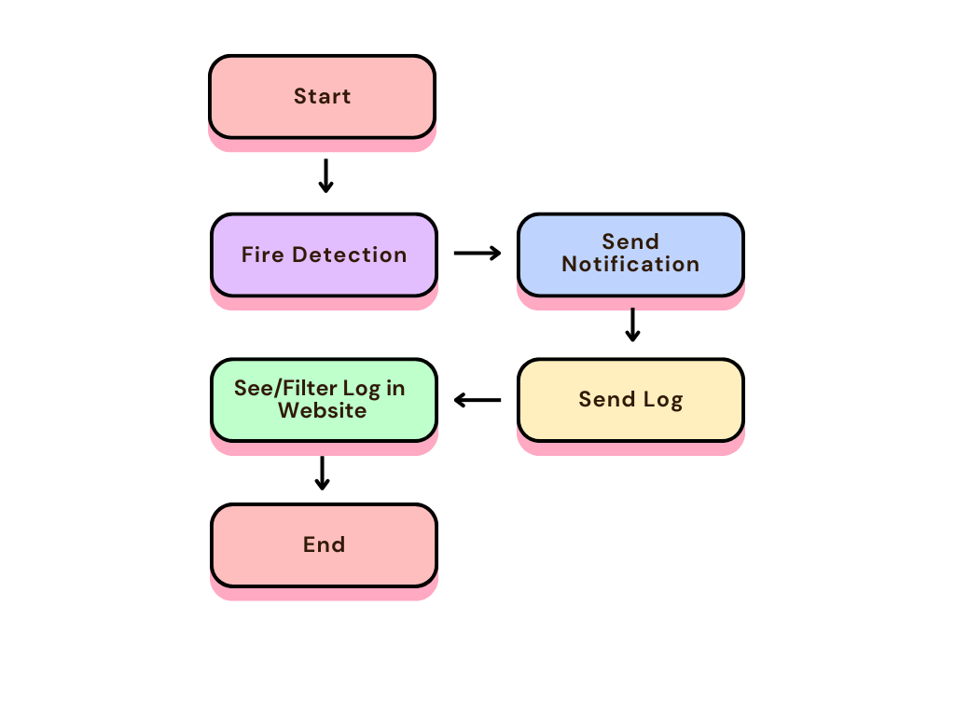
Workflow Diagram

Slide 11
Project Timeline
Month 1:
Initial research and planning.
Setting up the development environment.
Month 1.5:
Fire detection module (OpenCV & YOLOv8) development and testing.
Alerting system integration.
Month 2:
Firebase integration for logging.
Node.js web interface development.
Month 2 (End):
Full system testing, debugging, and deployment on Vercel.

Slide 12
Implementation Details
Implementation Details:
Fire Detection (YOLOv8 + OpenCV):
Setup: Used OpenCV to capture video frames from a camera feed and process each frame.
YOLOv8 Integration: Integrated YOLOv8 model pre-trained for fire detection. The model was fine-tuned with specific data for more accurate fire detection.
Real-Time Processing: The system processes frames in real-time and checks for fire within each frame. When fire is detected, it triggers the alerting and logging modules.
Alerting System (Twilio/Email):
SMS Integration: Integrated Twilio API for sending SMS notifications when fire is detected.
Alert Trigger: When fire is detected, the system sends an SMS with key event details such as detection time, location, and fire status.
Logging System (Firebase):
Database Design: Firebase Realtime Database was used to store logs of all fire detection events, with fields such as timestamp, fire status, and location.
Real-Time Updates: Logs are stored and updated in real-time to provide accurate and up-to-date information for analysis and monitoring.

Slide 13
Implementation Details
Web Interface (Node.js):
Backend: Developed a Node.js backend to handle requests and interface with the Firebase database to retrieve logs and display real-time fire status.
Frontend: Created a user-friendly interface where users can see detection status, historical logs, and alert notifications.
Deployment (Vercel):
Hosting: Deployed the web application on Vercel to ensure scalable and reliable hosting.
Real-Time Performance: Ensured the system’s backend and frontend are optimized for real-time data flow.

Slide 14
Conclusion
Project Success:
The real-time fire detection and alert system is fully functional, with accurate fire detection, real-time SMS alerts, and an interactive web interface.
Firebase logging provides valuable insights into fire detection events, allowing for future analysis and optimization.
Impact:
The system contributes to fire safety by providing faster detection and immediate alerts, potentially reducing the time to respond and preventing loss of life or property.
The integration of advanced technologies such as YOLOv8 for fire detection and Firebase for real-time data storage creates a robust and scalable solution.
Future Enhancements:
Future work could include expanding the system to support more environmental factors for detection (e.g., smoke, heat).
Further improvements could involve refining the model's detection accuracy and integrating with other emergency response systems.

Slide 15
References
https://firebase.google.com/docs
https://docs.ultralytics.com/
https://docs.opencv.org/4.x/index.html
https://docs.python.org/3/
https://docs.python.org/3/library/smtplib.html
https://vercel.com/docs

Slide 16
Any Questions?
Thank You !
MUNISH PATWA [21162121017]
ASTIK SAXENA [21162171002]
PANJWANI ANIKET [22162102002]

